Slide 1
Stabilization policy options in a “Lower and Longer” (L&L) interest rates environment
Prof. D.M. Nachane
Chairman, Centre for Economic and Social Studies (CESS), Hyderabad
Editor-in-Chief, Journal of Quantitative Economics

Slide 2
Outline
Introduction
Review of New Consensus Macroeconomics (NCM)
Zero Lower Bound (ZLB) is surmountable: Alternate mechanisms
Taxation / penalty mechanism (Gesell (1916), Goodfriend (2000))
Demonetization of large notes (Rogoff (2017)) – when would it work?
Dual currency proposal (Eisler (1932), Buiter (2009), Agrwal and Kimball (2015), Rogoff (2017))
Dealing with the liquidity trap – Policy measures
Revising the inflation target
Price-gap target
Reducing the long-term interest rate
Fiscal stimulus
Currency depreciation
Svensson’s foolproof strategy
Quantitative Easing (QE): Credit deadlock and instability of credit
QE: An unacknowledged debt to a forgotten economist
Hawtrey and QE – Hawtrey’s pioneering contribution

Slide 3
Introduction
During episodes of severe depression, interest rates can approach the zero lower bound (ZLB) and stay there for a fairly long time.
The unprecedented low levels of interest rates in the developed world (and to a lesser extent in the less developed world) during the Global Financial Crisis and the Covid-19 pandemic presented a challenge to received economic theory.
The phrase “lower and longer” (L&L) crept into policymaking usage to denote a situation where interest rates have sunk to extremely low levels either hitting the zero lower bound (ZLB) or staying close to it for a fairly long period.
US: 1931 - the yields on 4 to 6 months CP (commercial paper) rose from 4% to 6.25% in the two years preceding the Great Depression dropped to 2% for a short period from summer – late 1931
US: post GFC episodes of low interest rates exhibited a considerable hysteresis, persisting much longer than in the earlier episodes (L&L) – US Fed funds rate (the official policy rate) hit an unprecedented low of 0.8% in Sept 2008 and remained below 1% till Oct 2015.
Other economies: UK (~0.25% (Feb 2009-Aug 2016), Japan (Aug 1995-Dec 2023), India (relatively low – Jul 2008-Mar 2010)

Slide 4
Introduction
Mainstream macroeconomic theory (the so-called New Consensus Economics) fails to provide adequate guidance under a Taylor type rule to conventional monetary policy in response to periods of L&L during severe depressions.
The major alternatives to revitalize monetary policy can be divided into three categories viz.
(i) those that do not recognize the ZLB as an effective floor
(ii) those based on the Keynesian liquidity trap and
(iii) those based (implicitly) on Hawtrey’s credit deadlock.
Focus on QE while drawing attention to the largely ignored fact that QE had been suggested by the British economist Hawtrey at least as early as 1931 in the policy debates on ways to emerge from the Great Depression

Slide 5
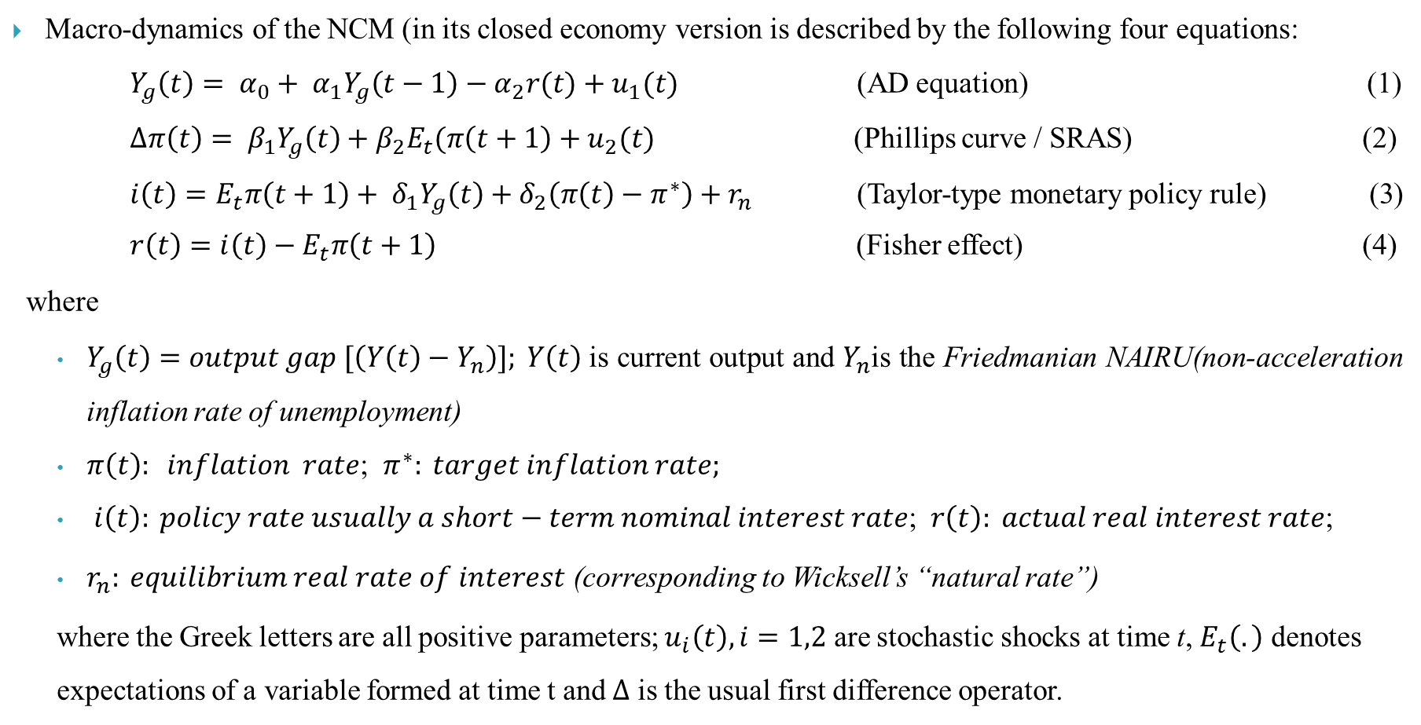
Review of New Consensus Macroeconomics (NCM)
Macro-dynamics of the NCM (in its closed economy version is described by the following four equations:
$Y_{g}\left(t\right)= {α_{0}+ α}_{1}Y_{g}\left(t−1\right)−α_{2}r(t)+u_{1}(t)$ (AD equation) (1)
$∆π\left(t\right)= β_{1}Y_{g}\left(t\right)+β_{2}E_{t}(π\left(t+1\right)+u_{2}(t)$ (Phillips curve / SRAS) (2)
$i\left(t\right)=E_{t}π\left(t+1\right)+ δ_{1}Y_{g}\left(t\right)+δ_{2}\left(π\left(t\right)−π^{∗}\right)+r_{n}$ (Taylor-type monetary policy rule) (3)
$r\left(t\right)=i\left(t\right)−E_{t}π\left(t+1\right)$ (Fisher effect) (4)
where
$Y_{g}\left(t\right)=output gap [\left(Y\left(t\right)−Y_{n}\right)]; Y\left(t\right)$is current output and $Y_{n}$is the Friedmanian NAIRU(non-acceleration inflation rate of unemployment)
$π\left(t\right): inflation rate$; $π^{∗}: target inflation rate;$
$i\left(t\right): policy rate usually a short−term nominal interest rate$; $r\left(t\right): actual real interest rate$;
$r_{n}: equilibrium real rate of interest$ (corresponding to Wicksell’s “natural rate”)
where the Greek letters are all positive parameters; $u_{i}\left(t\right), i=1,2$ are stochastic shocks at time t, $E_{t}\left(.\right)$ denotes expectations of a variable formed at time t and $∆$ is the usual first difference operator.

Slide 6
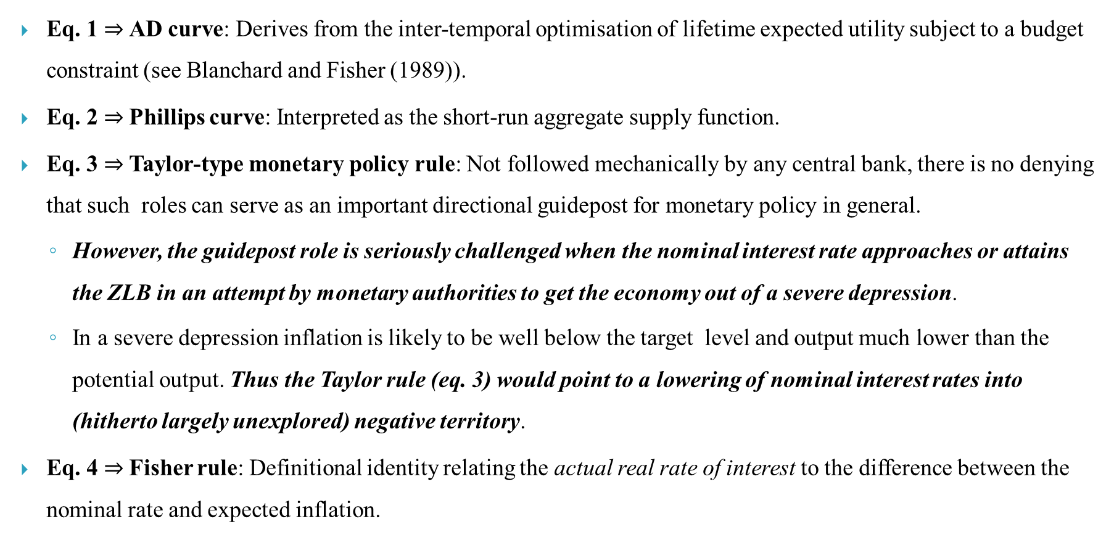
Review of New Consensus Macroeconomics (NCM)
Eq. 1 $⇒$AD curve: Derives from the inter-temporal optimisation of lifetime expected utility subject to a budget constraint (see Blanchard and Fisher (1989)).
Eq. 2 $⇒$Phillips curve: Interpreted as the short-run aggregate supply function.
Eq. 3 $⇒$Taylor-type monetary policy rule: Not followed mechanically by any central bank, there is no denying that such roles can serve as an important directional guidepost for monetary policy in general.
However, the guidepost role is seriously challenged when the nominal interest rate approaches or attains the ZLB in an attempt by monetary authorities to get the economy out of a severe depression.
In a severe depression inflation is likely to be well below the target level and output much lower than the potential output. Thus the Taylor rule (eq. 3) would point to a lowering of nominal interest rates into (hitherto largely unexplored) negative territory.
Eq. 4 $⇒$Fisher rule: Definitional identity relating the actual real rate of interest to the difference between the nominal rate and expected inflation.

Slide 7
Zero Lower Bound (ZLB)
Basic problem with lower and longer interest rates is that it makes currency more attractive to hold than bonds as the liquidity offered by currency outweighs the low interest on bonds.
Economists have suggested numerous solutions to overcome the ZLB (including some being adopted by policymakers) which can be classified taxonomically into three broad categories :
Suggestions that the ZLB is not unsurmountable
Those based explicitly on the Keynesian theory of liquidity preference and the liquidity trap
Those which are based on the Hawtreyan concept of credit deadlock (Most of those suggesting these measures seem to be unaware of their origin in the 1920-40 works of Hawtrey (see Hawtrey (1928, 1932, 1950 etc.))

Slide 8
Solutions: ZLB is surmountable
Taxation mechanism on currency to cancel the advantage of currency over bonds :
If the nominal interest on bonds were made say -0.5% , in the absence of a penalty on currency holdings, there would be a flight to currency and bond markets would collapse. If a penalty on currency holdings were levied amounting to 0.75% say, then such a situation could be averted.
Earliest penalty mechanism was proposed by Gesell (1916): Requirement of periodically affixing stamps on currency notes, so that the longer one held a currency note the greater the penalty.
A modified modern technology version of penalty: Replace the stamp requirement by that of magnetic strips (see Goodfriend (2000)). Even in its modern version this scheme would present several difficulties in implementation and therefore ranks low on feasibility.

Slide 9
Solutions: ZLB is surmountable
Demonetization of large notes (see Rogoff (2017)): a more practical alternative
Demonetization would force the hoarders of large notes (mainly in the shadow economy) to change their currency hoards into smaller notes thus increasing the costs of carrying and storage considerably.
Method is likely to work only where the large notes’ denomination substantially exceeds the denominations most favoured in the bulk of national transactions, or alternatively the large notes are primarily used for hoarding in the shadow economy rather than for ordinary transactions.
If this condition is not fulfilled the demonetization experiment is likely to have very little impact on the shadow economy — the Indian demonetization of 2016 being a recent example.
Demonetization also poses severe problems for the agriculture and rural sectors, where most transactions are conducted via cash (which was also experienced in the Indian context).

Slide 10
Solutions: ZLB is surmountable
Dual currency proposal (Eisler (1932), revived again by Buiter (2009), Agarwal and Kimball (2015) and Rogoff (2017))
Government should declare that all government contracts, taxes and fees etc. are denominated in electronic currency (though payable in both types of currencies – physical and electronic). The two currencies are then related via an exchange rate fixed by the government.
Government can easily impose a negative interest rate on electronic currency and then set the exchange rate between the two currencies in such a way that the paper currency also gets slapped with a negative carrying cost (see Rogoff (2017), p. 58).
A major issue (compared to feasibility) is the desirability of the negative interest rate. With very low or negative interest rates, bond markets are likely to freeze up in view of the low/negative yields on risk free government securities, which would drive large financial institutions like insurance companies, pension funds etc. (who are obliged to give guaranteed rates of return on their liabilities) to invest in more risky assets. Banks would face a deposit flight as retail depositors switched to equity markets, or physical assets such as precious metals or commodity futures. The traditional functioning of banks viz. loans against collaterals will erode bank profitability requiring large scale infusions of capital by the government in nationalized banks, while many private banks would fail. Overall, negative interest rates hardly appear to be an appealing method in getting out of a deep recession, more so for an emerging or less developed economy.

Slide 11
Keynesian liquidity trap
Keynesian liquidity preference theory: The interest rate is the reward demanded by economic agents to relinquish their control over liquidity. Keynes focused on the speculative motive of the 3 motives, as it was unpredictable, and played a key role in determining market interest rates.
The liquidity preference schedule is downward sloping (as the reward for parting with money decreases, people desire to hold more of it) and it flattens out towards the right i.e. the demand for money becomes infinitely elastic at a particular low level of interest, which is dubbed the liquidity trap. It occurs because of two factors:
(i) at very low rates of interest, there is always the expectation that the interest rate may rise
(ii) a small rise in the interest rate imposes huge losses on bond holders when the interest rate is very low.
Policy measures to deal with ZLB based on the liquidity trap:
Revising the inflation target
Price-gap target
Reducing the long-term interest rate
Fiscal stimulus
Currency depreciation
Svensson’s foolproof strategy

Slide 12
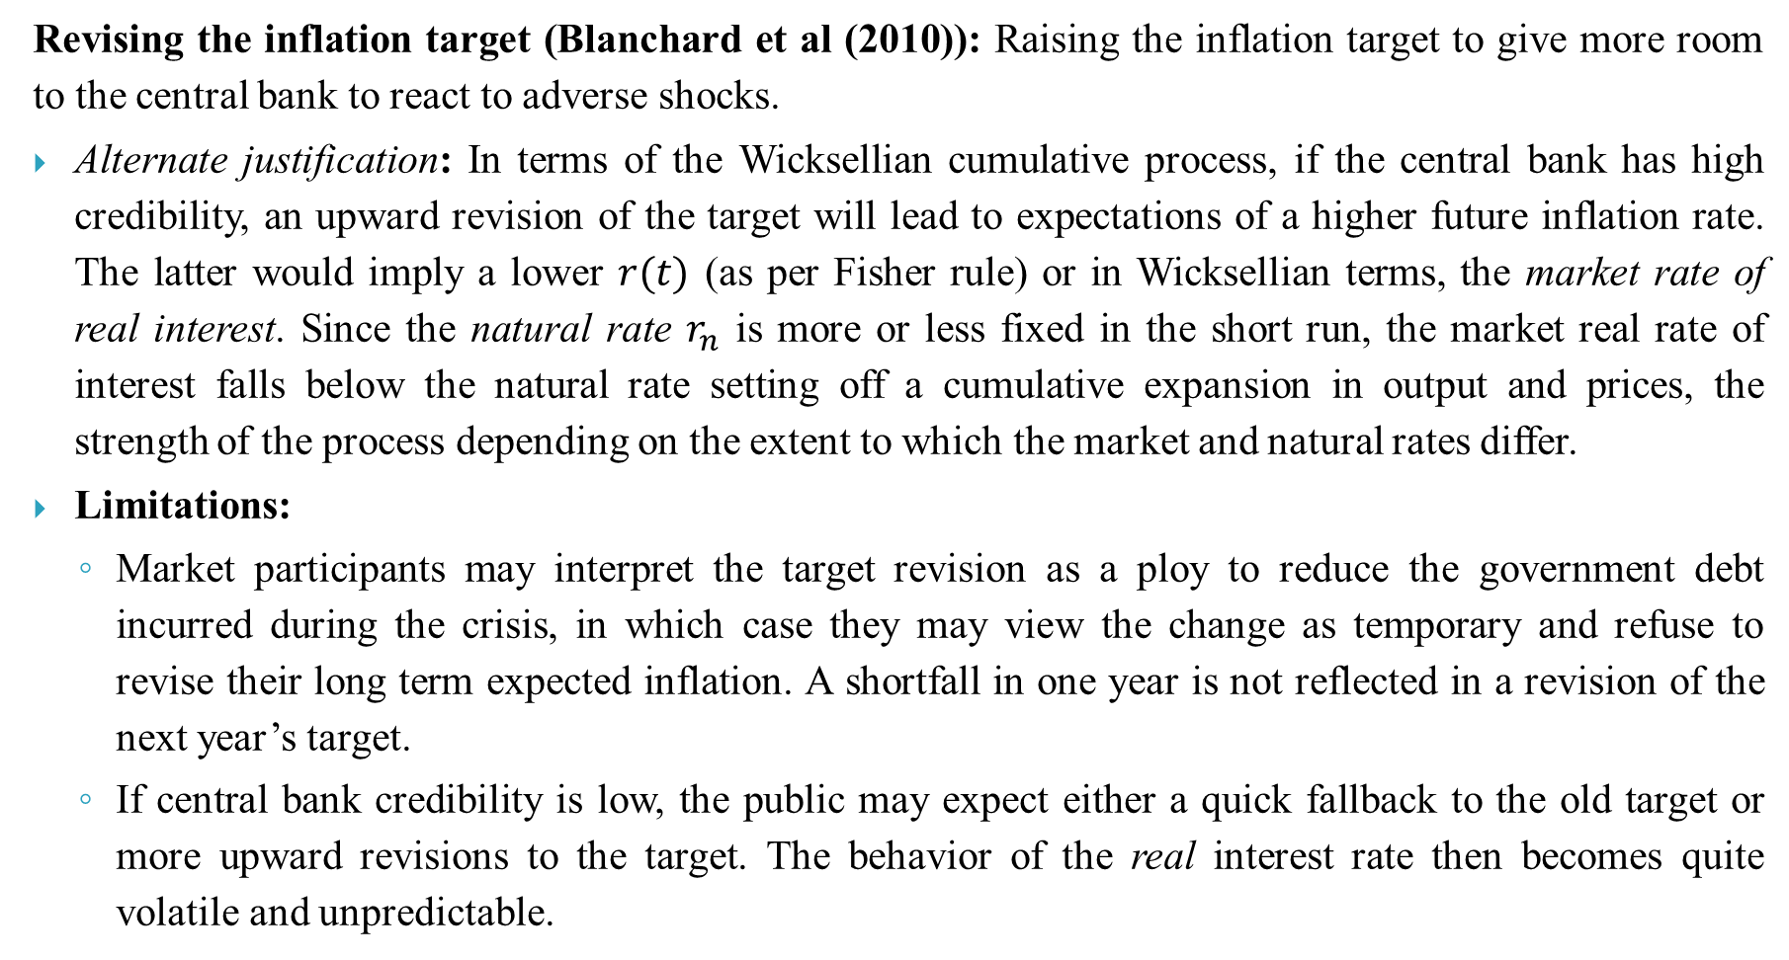
Solutions to ZLB based on the liquidity trap
Revising the inflation target (Blanchard et al (2010)): Raising the inflation target to give more room to the central bank to react to adverse shocks.
Alternate justification: In terms of the Wicksellian cumulative process, if the central bank has high credibility, an upward revision of the target will lead to expectations of a higher future inflation rate. The latter would imply a lower $r(t)$ (as per Fisher rule) or in Wicksellian terms, the market rate of real interest. Since the natural rate $r_{n}$ is more or less fixed in the short run, the market real rate of interest falls below the natural rate setting off a cumulative expansion in output and prices, the strength of the process depending on the extent to which the market and natural rates differ.
Limitations:
Market participants may interpret the target revision as a ploy to reduce the government debt incurred during the crisis, in which case they may view the change as temporary and refuse to revise their long term expected inflation. A shortfall in one year is not reflected in a revision of the next year’s target.
If central bank credibility is low, the public may expect either a quick fallback to the old target or more upward revisions to the target. The behavior of the real interest rate then becomes quite volatile and unpredictable.

Slide 13
Solutions to ZLB based on the liquidity trap
Price-gap target (stronger version of inflation target revision measure):
Announce an upward-sloping target path for the price level (see Svensson (2003)) or as Bernanke (2003) suggests, a proposal to bridge the price-level gap defined as the difference between the actual price level and the price level that would have prevailed if deflation had been avoided and price stability maintained at the pre-deflation level.
Advantage: The shortfalls in any period are loaded onto the next period’s price-gap, prompting firmer expectations of future inflation among market participants.
Fundamental issue: Wicksell’s cumulative process is an analysis of secular changes in prices (Hansson(1990), p. 261). The cumulative process is aborted in the presence of sticky money wages and only if the macroeconomic shocks are large enough to break through this wage inflexibility will the cumulative process apply. In short, the cumulative process applies only under flexible money and wages, which can only prevail in a modern economy in the long run.

Slide 14
Solutions to ZLB based on the liquidity trap
Reducing the long-term interest rate: is the primary consideration for long-term consumption and investment plans and avoids the Wicksellian objection.
Reduction can be achieved via the Operation Twist in which the central bank buys longer-term securities in exchange for short-term securities. This results in lowering short-term security prices and raising the prices of long-term securities resulting in a twist to the yield curve which rises at the short end and falls at the long end (see Bernanke (2002) and Meltzer (2001)).
Limitation: Its application depends on the store of long-term securities with the public and by the reluctance of large financial institutions to part with safe long-term securities in exchange for short term paper.

Slide 15
Solutions to ZLB based on the liquidity trap
Fiscal Stimulus: Keynes’ General Theory advocated an aggressive fiscal policy through public expenditure/tax cuts as a way of stimulating the economy out of a deep recession (pessimistic about effectiveness of monetary policy in surmounting liquidity trap).
Critique: Hawtrey (1933) was quite opposed to this method of getting out of a recession. Hawtrey’s position is very close to what was then described as the Treasury view, though it is not very clear whether he was the chief architect of this view (having been closely associated with the Treasury for a very long period).
Interestingly, Hawtrey felt that public expenditure financed by bonds, would simply displace private expenditure (an early expression of crowding out effect). However, if the fiscal deficits were financed by deficit financing (creation of new money) they would have a useful role to play in ending the credit deadlock. But then it was the associated money creation, rather than the direct fiscal expenditure which was the key element in the revival (Hawtrey (1928) and Laidler and Sandilands (2002), p. 524).

Slide 16
Solutions to ZLB based on the liquidity trap
Currency depreciation: supplemented with a switchover to a crawling peg regime.
This is combined with an exit strategy of abandoning the crawl at a future date in favour of inflation or price level targeting. A currency depreciation can act as a stimulus to the export sector and also as a signal for future inflation. This will serve to firm up future inflationary expectations and thereby an expectation of a real interest drop.
While this option may be available to a small open economy, it is doubtful if a major country with a large export sector can adopt this strategy without considerable repercussions in the global commodity and forex markets (Svensson (2003)).
Other trading partners who would most likely be facing the same situation (as happened during the Great Depression and the more recent Global Financial Crisis) would most likely follow suit destabilizing global markets. Besides the exit strategy may not be fully credible either with domestic economic agents or with trading partners.

Slide 17
Solutions to ZLB based on the liquidity trap
Svensson’s foolproof strategy: Svensson (2001, 2003) suggested a combination of currency depreciation and a price-gap target. The strategy consists of announcing and implementing the following three measures:
An upward sloping price-level target path, starting above the current price level by the price gap that has to be eliminated.
A depreciation and a crawling peg of the currency (see footnote 13)
An exit strategy committing the Central Bank or Commerce Ministry to abandon the peg in favour of inflation or price-level targeting once the price-gap has been bridged.
Limitation: Success subject to credibility of the Central Bank and has the same limitations as the currency depreciation and a price-gap target in a stand alone context.

Slide 18
Quantitative Easing (QE)
By December 2008, the federal funds rate had attained the ZLB being in the range 0 to 0.25%.
But the financial crisis was in full swing with the real sector now contracting and unemployment climbing up.
Little scope for conventional monetary policy, led to unconventional monetary policy measures.
Operating on market expectations – the so-called forward guidance under which the central bank can resort to a commitment to maintain the policy rate at the ZLB for a sufficiently long period of time (see Dotsey (2016)). But such forward guidance cannot be credible unless backed by a large portfolio of securities at the central bank.
The central bank can also operate on the cost of long-term credit by purchasing long-dated government securities, MBS (mortgage based securities), corporate bonds etc. and thereby driving down long-term yields on such assets.
Thus the central bank needed to expand its balance sheet by purchasing government and private securities from the market – a process commonly dubbed as quantitative easing (QE).
Additionally QE is sometimes used to reduce the risk premium on illiquid or impaired markets by central bank purchases of such tainted assets.

Slide 19
Quantitative Easing (QE)
The FRB conducted the QE operations in three phases.
QE1: concluded in the first quarter of 2010, with a total of $1.25 trillion in purchases of mortgage-backed securities, $300 billion in Treasury bonds and $175 billion in federal agency debt.
QE2: commenced on 3 Nov. 2010 and involved an additional purchase of $600 billion of longer-term Treasury securities. It was terminated at the end of June 2011.
QE3: commenced on 13 Sept. 2012, and involved Fed purchases of an additional $40 billion of MBS each month till the phase lasted. Unlike the earlier two phases, which were ended abruptly, QE3 was tapered beginning 18 December 2013 to end on 29 October 2014. This was accomplished by a progressive reduction of $ 10 billion in the Fed’s $85 billion monthly asset purchases schedule.
In India, QE was attempted, not in response to the Global Financial Crisis but later during the Covid pandemic.
On 8 Apr. 2021, the RBI announced the G-Sec Acquisition Programme G-SAP1 under which the RBI would purchase Government securities (of maturities ranging from 2 to 14 years) amounting to Rs. 25,000 crores. The G-SAP2 was announced on 4 June 2021 for an aggregate amount of Rs.15,000 crores, covering Government securities of maturity between 5 to 14 years.

Slide 20
Quantitative Easing (QE)
Most observers attribute a measure of success to QE in restoring the US economy from a deep recession (see Baumeister and Benati (2010), Chung et al. (2012)etc.).
However as QE was in parallel operation to other measures such as conventional monetary policy easing and fiscal stimulus, there is always a problem of attributing success for the actual recovery to the various measures individually.
The recovery may be said to have begun in the US from 2010 onwards, judged by the metrics of GDP growth, gross capital formation and unemployment (Nachane (2018, p.137)).
Some recent empirical evidence attributes considerable success to QE policies (Wu and Xia (2016), Kucharc ̌ukova ́ et al (2016), Cochrane (2015), Nasir (2021) etc.).
There is virtually no recognition in the recent literature to the fact that the idea of QE not only dates back to the British economist Hawtrey but that he made contributions to the development of it as a policy tool (during the Great Depression of the 1930s) owing to his long association with the British Treasury (1919-1944).

Slide 21
QE: An unacknowledged debt to a forgotten economist
Hawtrey’s ideas span two decades (1913-32) and are developed in five monographs viz. Hawtrey (1913, 1925, 1928, 1931 and 1932). Hawtrey is remembered majorly as the chief proponent of the Monetary Theory of the Trade Cycle. But the various details of his analysis seem to have been largely ignored. One such feature is the inherent instability of credit.
Hawtrey’s monetary theory of the trade cycle derives its appellation from the fact that he held monetary shocks to be the prime cause of cycles in the sense that: (i) monetary shocks are capable of generating cumulative expansions and contractions (ii) non-monetary causes can possibly generate a disturbance but it cannot be cumulative unless underwritten by an accommodative monetary policy.
Hawtrey assigned a great deal of importance to the role of dealers (merchants and wholesalers) in the trade cycle. Dealers are extremely sensitive to changes in the short-term rate of interest. This rate varies directly with the demand for commercial loans, the latter in turn reflecting parallel movements in general macroeconomic activity

Slide 22
QE: An unacknowledged debt to a forgotten economist
The upswing of the trade cycle arises if the central bank reduces its discount rate or increases its purchase of securities from banks and the public. This is shortly followed by a credit expansion via a reduction of the interest rate on loans combined with an easing of terms under which loans are granted. Credit expansion results in rise in consumers’ outlay (defined in Hawtrey to include consumption expenditure together with outlays on new investment goods).
As consumer outlays increase, dealers raise their inventory levels with additional orders to manufacturers. Manufacturers respond by first increasing the production levels and as full capacity is approached, by raising prices. The rising prices further stimulate profits since Hawtrey believed that wages responded with a lag to prices (see Kessel and Alchian (1962)).
The process thus becomes cumulative (Haberler (1964, p.17-24) and Deutscher (1990, p.58-68)).
The upswing continues until the credit expansion is reversed with a rise in the bank rate or open market sales. It is interesting to note that Hawtrey (see (1928), p. 98) did not believe that the upswing would terminate of its own accord but that it could continue indefinitely were it not for the constraints on monetary expansion due to the gold bullion standard prevailing at that time (1925-31) in Britain (see Eichengreen (2019) and Drummond (1987)).

Slide 23
QE: An unacknowledged debt to a forgotten economist
The downswing of the cycle is also cumulative and follows the obverse route of the upswing.
As credit contracts, prices fall but wages being inflexible downwards, profits contract rapidly forcing cutbacks in production. This forces inventories to lie idle with dealers, borrowing is reduced further along with consumers’ outlay and so on.
Reviving the economy from a downswing depends to a large extent on how severe the depression is.
If the depression is not too severe, then the liquidation of loans brought about by debtors who fear an increase in their debt burden (due to the actual and expected fall in prices) would restore bank reserves to their normal levels and banks once again become wiling lenders and try to allure borrowers with lower interest rates and relaxation of loan conditions. However, this process works reasonably well only if pessimism among the dealers is not too high regarding future evolution of consumers’ outlay.
If the depression is severe, then recovery might present serious problems. This situation Hawtrey famously termed as a credit deadlock (Hawtrey (1933), p. 29).

Slide 24
QE: An unacknowledged debt to a forgotten economist
“ Since the early 1990s , borrowers in Japan have repeatedly found themselves squeezed by disinflation or deflation, which has required them to pay their debts in yen of greater value than they had expected. Borrower distress has affected the whole economy, for example by weakening the banking system and depressing investment spending”. - Bernanke (2003)
The instability of credit is enhanced by the pro-cyclicality of the velocity of money. Cash balances are reduced (increased) when credit is expanding (contracting) and prices are rising (falling). This phenomenon accentuates the cyclical movements of consumers’ outlay.
Hawtrey and QE:
Hawtrey had given considerable thought to the policy measures that could be adopted to emerge out of the credit deadlock.
Hawtrey (1933, p.141): examined the possibility of a reduction in nominal wages in line with the price level to restore manufacturers’ profit levels. Rejected this proposal as entailing severe social and political dislocations.
A reduction in real wages was a more practicable alternative to serve the same purpose. This could be achieved either by inflation or currency depreciation.

Slide 25
Hawtrey and QE
In evidence before the Macmillan Committee (1931a, p. 273-277), Hawtrey succinctly outlines his main proposal for emerging out of the deadlock during the Great Depression.
When asked about his views on monetary policy, he said that for the short term he would favour further reductions in the short term interest rate (and possibly the cash reserve ratio of banks, though he does not mention this latter explicitly) supplemented by open market purchases or in his own words “to carry the process of credit relaxation to its limit”. But he clearly realized that this policy cannot continue for too long after the deadlock is broken, for fear of a runaway inflation.
In the long run, he laid down the objective of stabilizing the price level (see Deutscher (1990), p. 84-85 and Clarke (1988) ). Laidler (2004) calls this double-barreled strategy as the Purvis Principle.
Hawtrey emphasized open market operations as the best (or perhaps the only) way to get out of the credit deadlock. “… the purchase of securities by the Central Bank, which is otherwise no more than a useful reinforcement of the Bank rate …becomes an essential condition of the revival beginning at all.”(Hawtrey (1931b)).
While Hawtrey assigns a great deal of significance to open market purchases by the central bank, he does not draw a clear distinction between traditional open market operations and these special open market purchases (or QE).

Slide 26
Hawtrey and QE
The main distinction between Hawtrey’s traditional OMOs and QE hinge upon three factors :
Under an expansionary OMO, the central bank purchases assets (usually long-term securities) from banks and financial institutions, but this is funded through some existing central bank assets such as short-term securities, foreign currency holdings, gold etc., so that banks get hold of relatively more liquid assets while the size of the central bank balance sheet is left unchanged. QE, on the other hand, funds the asset purchases from banks and other financial institutions by increasing the monetary base, in the process expanding the size of the central bank balance sheet.
While OMO purchases are confined to government securities, asset purchases under QE can be extended to other financial instruments including corporate bonds, MBS etc.
OMO are typically addressed to maintain the market short-term interest rates around a desired level, QE is directed at influencing the long-term interest rate.

Slide 27
Hawtrey and QE
Analyzing each factor:
Even though Hawtrey did not specifically make the distinction explicitly in the first factor, his writings make it clear that what he had in mind was very close to what we now understand by QE.
The second factor is subsumed implicitly under Hawtrey’s credit relaxation. Hawtrey (1950, p.75) did not hesitate to suggest that “they (banks) can create credit by themselves buying securities in the investment market”, which is a step undertaken with a great deal of caution by most countries embarking upon QE. In India, for example, banks’ investment portfolios should be within the framework prescribed by the RBI.
On the third factor, Hawtrey was clear that the Central Bank can only control the short-term interest rate with very little influence on the long-term rate.
On balance, one may say that the profession today has been less than just in allotting Hawtrey due credit as the originator of QE. Hawtrey’s views were, however, quite popular with a section of American economists in the 1920s and 1930s notably Currie (1933, 1934), Young (1924), Simons (1936) etc. (see the discussion in Humphrey (1971), Johnson and Rees ((1962), Sandilands (1990), Laidler (1993, 2004) etc. ).

Slide 28
Conclusion
The proposals to tackle the ZLB fall under three categories viz.
those that believe that in these days of electronic money, cash is an anachronism and that the ZLB should not be treated as an insurmountable barrier
those that rely on the Keynesian liquidity trap and
the few that rely on Hawtrey’s credit deadlock (without perhaps explicitly realizing it).
The first two of these proposals rely primarily on the policy interest rate to the virtual neglect of money supply. The last relies on the policy rate (bank rate in Hawtrey’s times) as a first line of action to be followed by QE if necessary.
The question that naturally presents itself, is which method is to be recommended. A proper judgement on this question is obfuscated by the fact that in both the Great Depression of the 1930s and the more recent Global Financial Crisis, several methods were running parallel making it difficult to econometrically untangle their separate influences. And it goes without saying that the success of any proposal would be context-dependent.
The one lesson that the Global Financial Crisis has brought home is that economic ideas never become obsolete. By surrendering ourselves completely to the most recent mainstream theory, we close our minds to the valuable thinking of the past (both theoretical and empirical). Policy improvement can only occur when we assimilate and embed our inherited knowledge within the current state of our understanding.

Slide 29
Thank You

